Slide 1
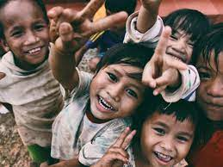
Zero Hunger and Donation

Slide 2
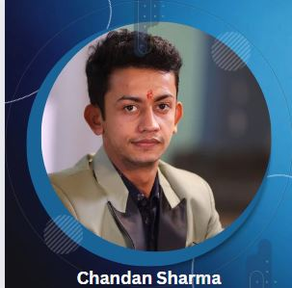
PARTICIPANTS
Sai Kiran
Pragati Sawant
Team FireCodians

Slide 3
Logo

Slide 4
The problem
Context
Zero hunger refers to putting the numbers to zero death rates due to food not on tables
Donation refers to donate the stationary ,clothes ,utensils which you have at your home and you not use it now and you want to declutter and wish to help by giving it to a needy.
Developers showing the direction to volunteers how the system works .
Volunteers showing the directions to the providers and receivers on the execution part.

Slide 5
Problem statement
Addressing the issue of waste of food in marriages,birthday parties, and corporate functions etc ,volunteers and developers can contribute .
We choose this issue Hunger as it is an prevailing issue which is degrading our country with unhealthing generations

Slide 6
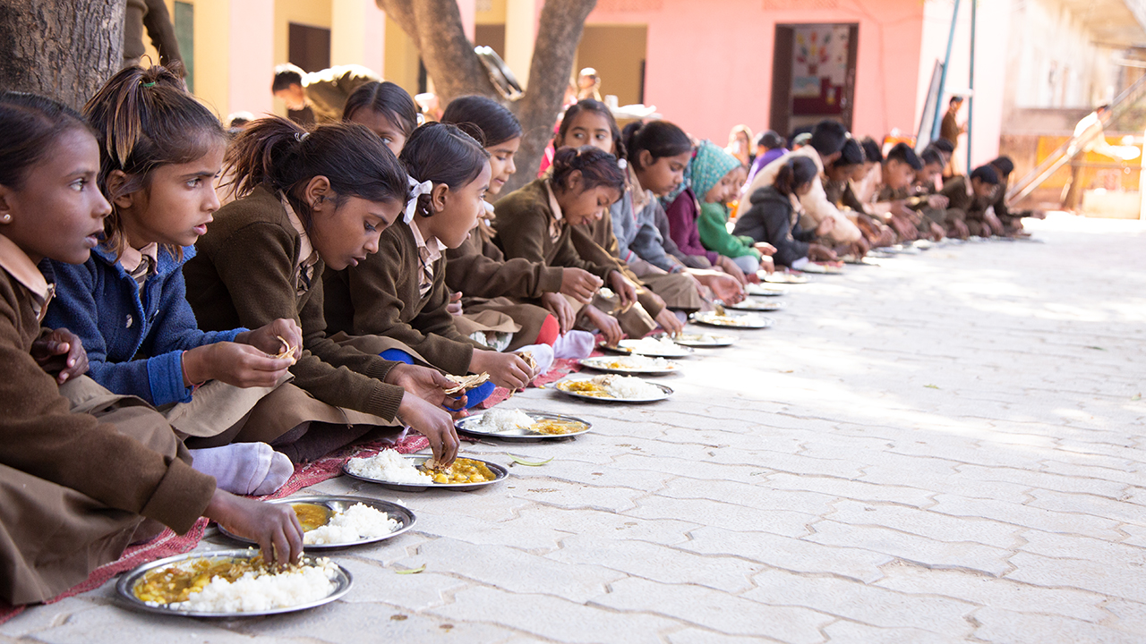
Implementation

Slide 7
Receivers
Providers
Hub

Slide 8
Providers
The provider is a person or company that provides food
Eg : Individuals ,Families, Carters, wedding parties, birthday parties etc.
Receivers
The receiver is a person or non profit companies,NGO, old age homes which takes the food and donation.
Hub
A hub is an offline place where we have a group of volunteers tracking the records request and response.
Items
Items are the categories which are donated.
Eg;Food , clothes, Stationeries,Utensils

Slide 9
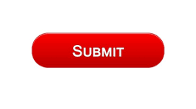
Provider/Receiver

Slide 11
Thank You

