Slide 1

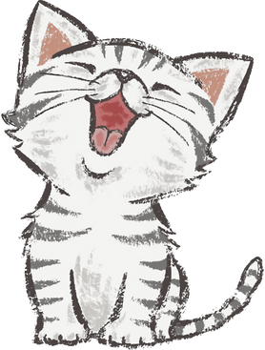

TEAM CODE-RANGERS
PRESENTS
PAWFECTION

Slide 2
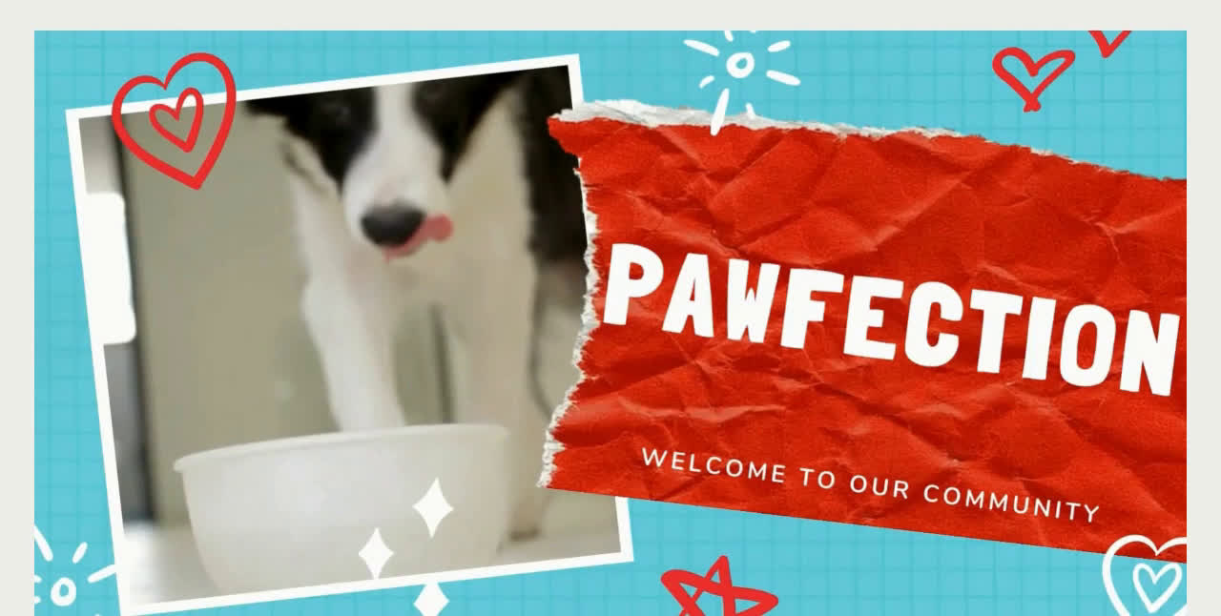
Please play below video -

Slide 3


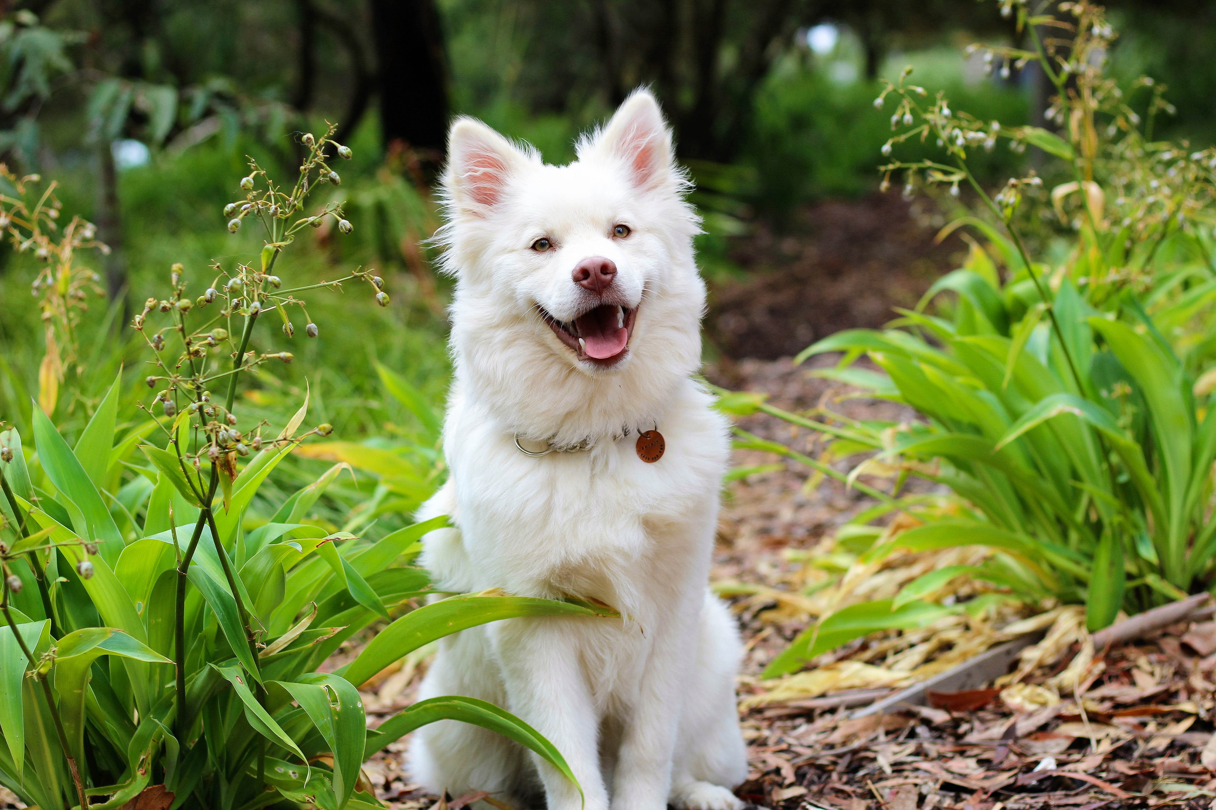
OH YOU MAKE MY HEART GO
BAM!
A Story about Love, Compassion & Care
One-Stop solution for Pets & Owners
A Pet-Owner Community

Slide 4
Motivation
Welcome to Pawfection, where the love for pets knows no bounds!
We believe that every wag of a tail, every purr, and every feathered friend deserves a place to call home within our vibrant community.
Pawfection, the community that understands the unique bond between them and their beloved companions.

Slide 5


Existing Platforms vs Pawfection
 | Shelter Me | Petzbe | Pawfection
Feeds
Profiles
News
Chats
Blogs

Slide 6
Existing Platforms vs Pawfection
 | Shelter Me | Petzbe | Pawfection
AI suggestions
MarketPlace
Training Videos
Injured Animals Enquiry
Contact Us

Slide 7

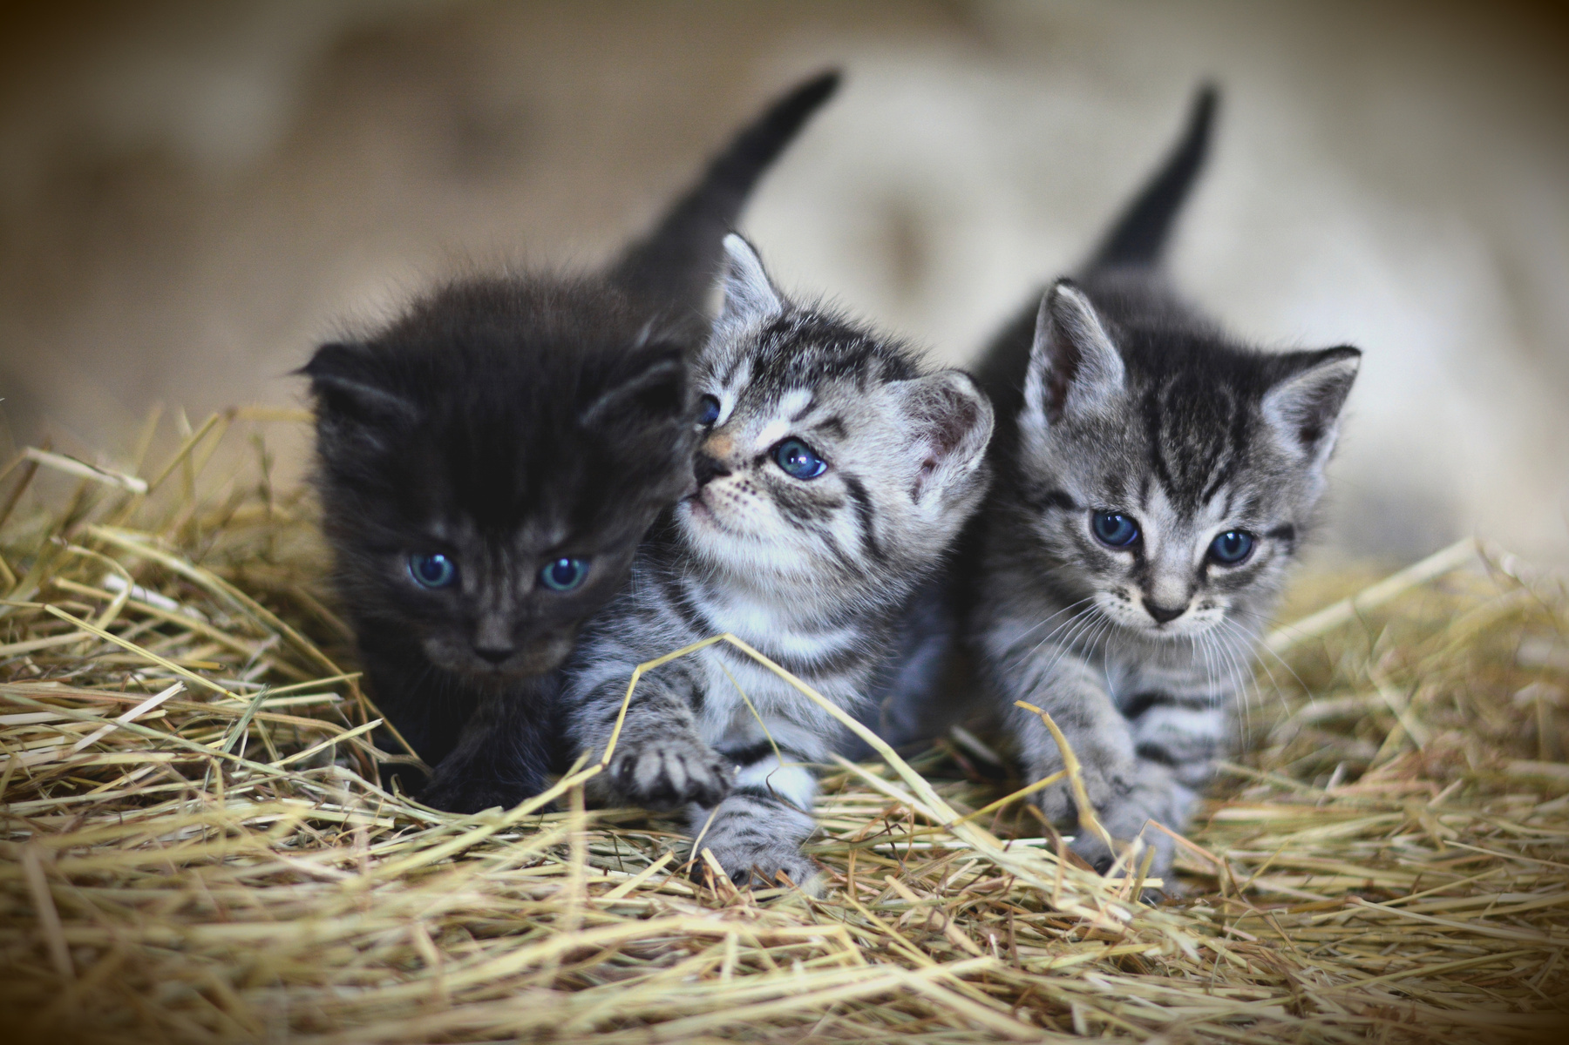
FEATURES
INCLUDED:
1.Share cool images of Pet
with the world

Slide 8
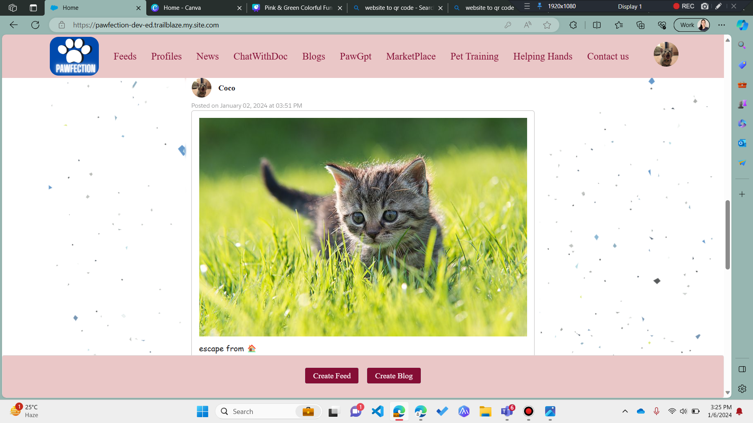
Feeds

Slide 9
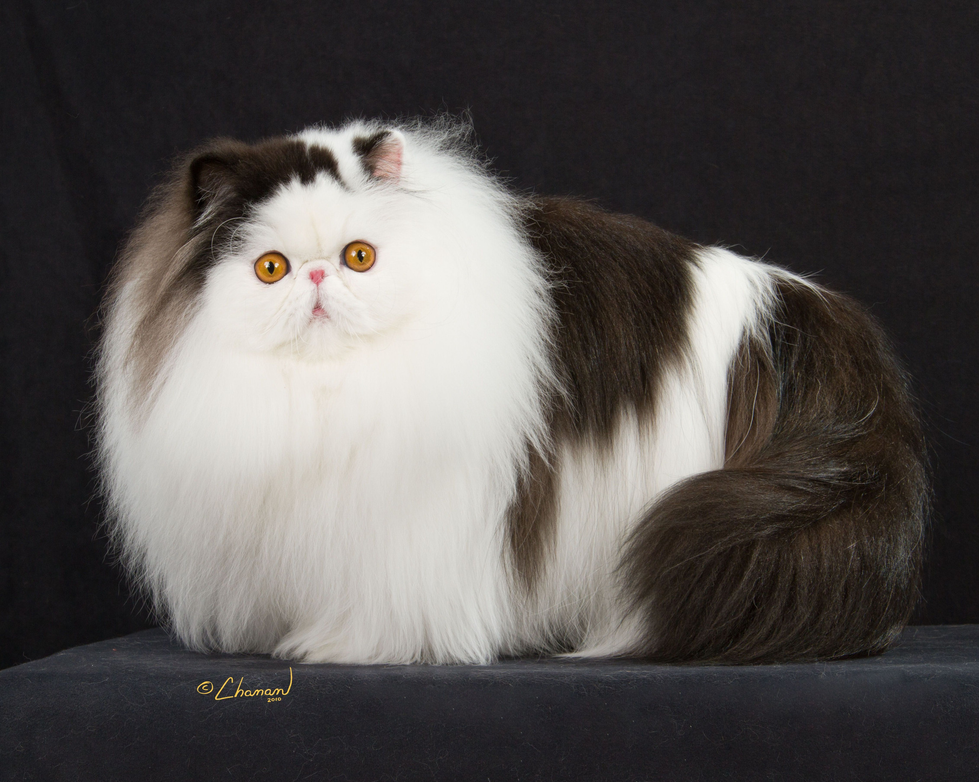
2.SHARE & READ LOVELY EXPERIENCES (BLOGS)
You were so happy and excited.
We made eye contact, and the rest was history.

Slide 10
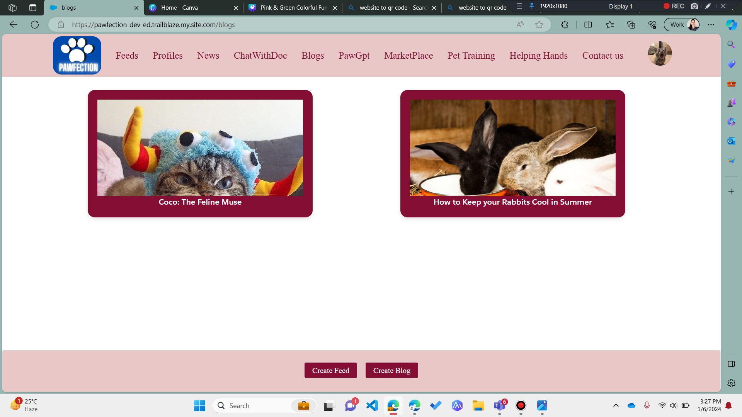
Blogs

Slide 11
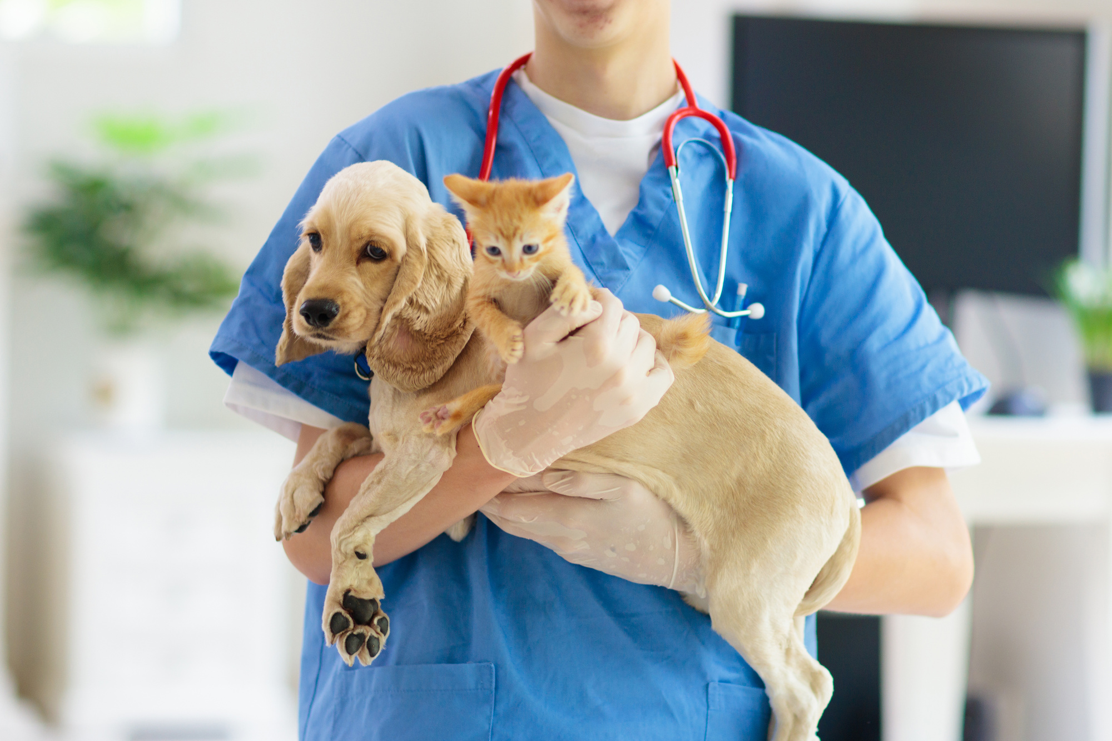
WE'VE BEEN INSEPARABLE EVER SINCE.
3. Chat with doctors directly via our app

Slide 12
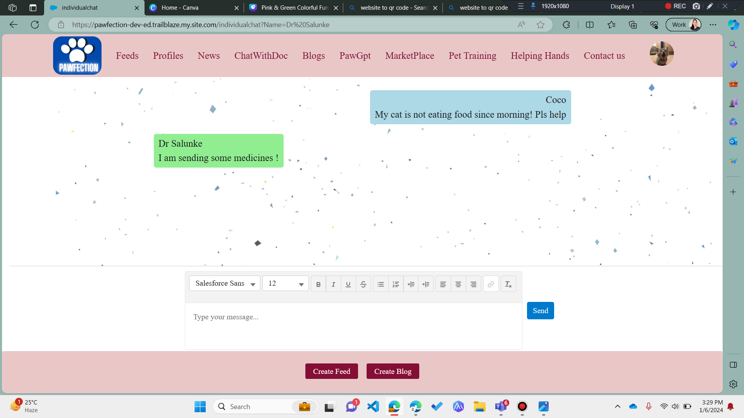
Chat with doctors

Slide 13
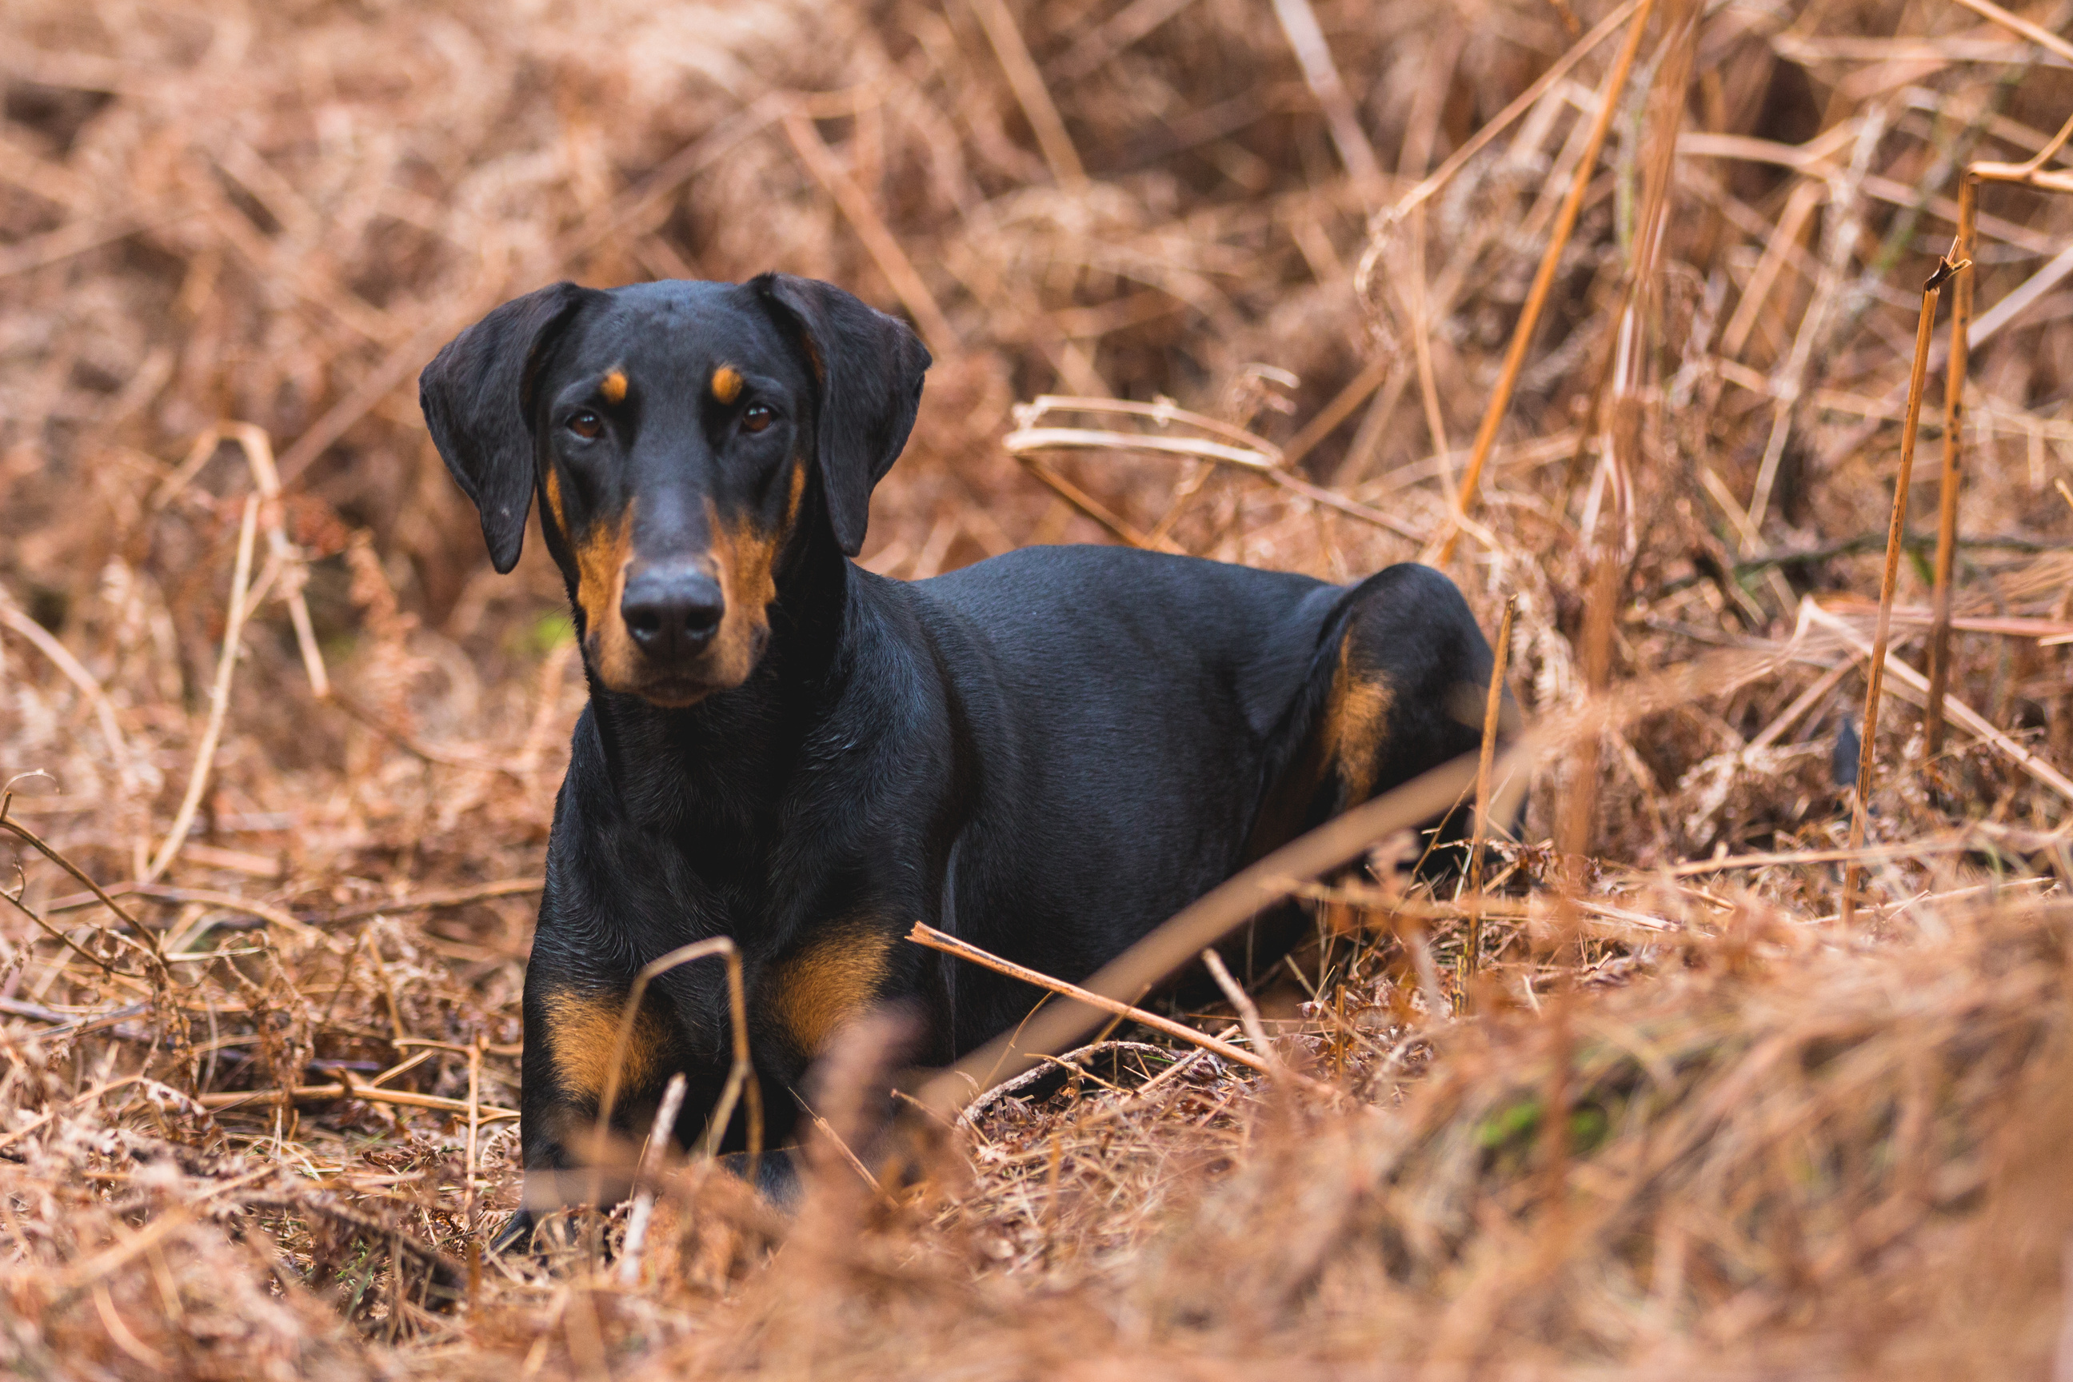
YOU ALWAYS LOOK AFTER ME.
4. A DEDICATED PAGE TO POST ABOUT INJURED ANIMALS

Slide 14
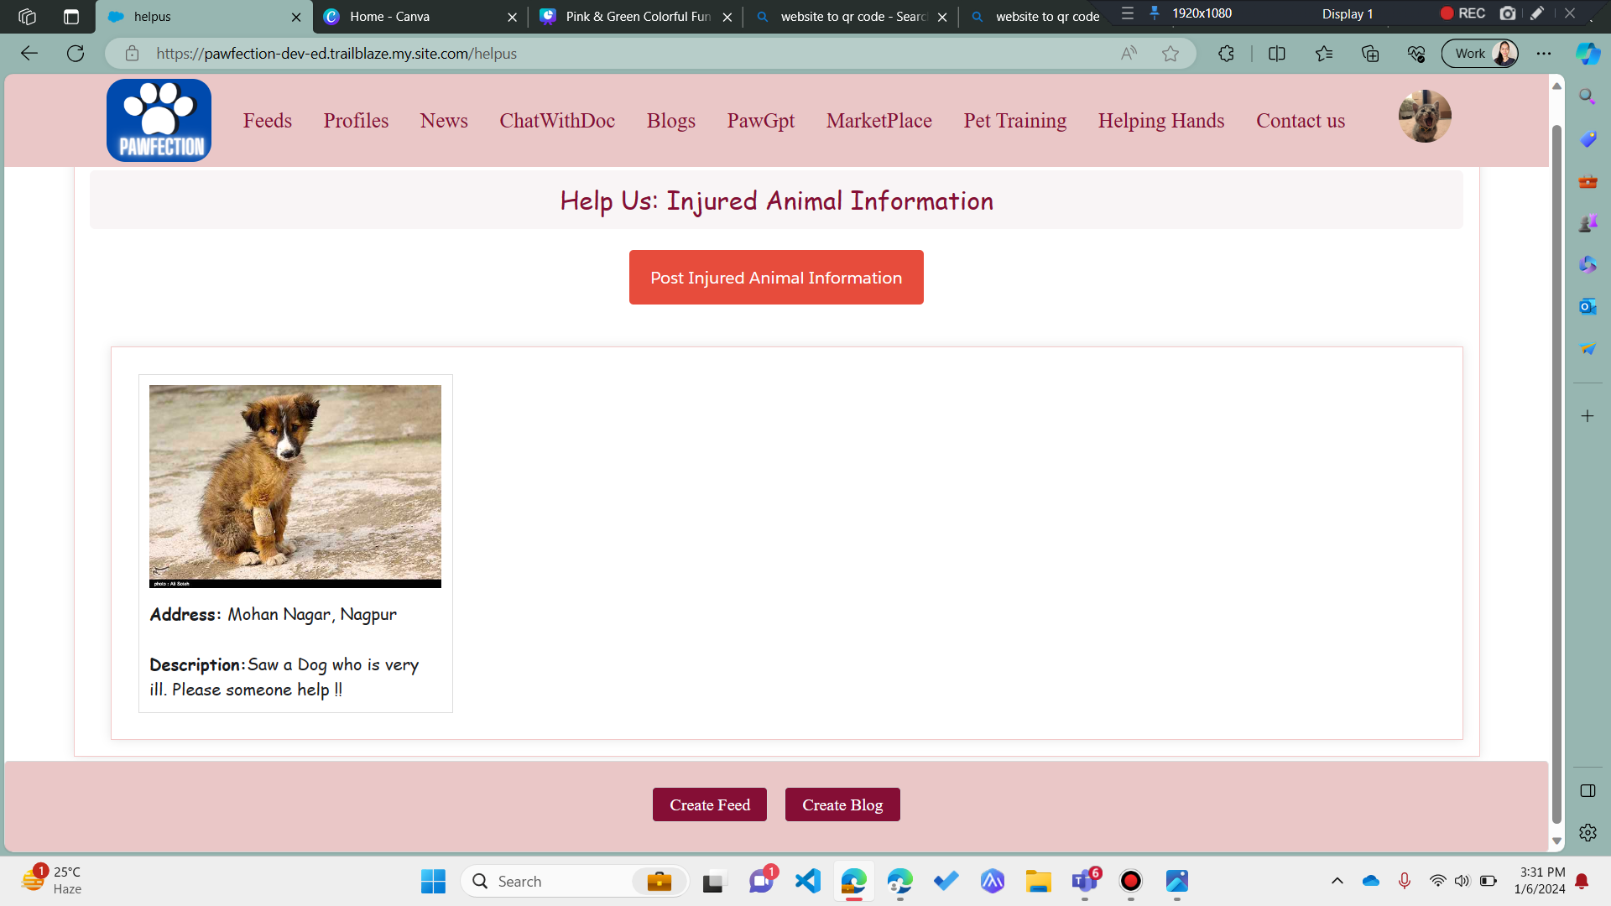
Helping Hands

Slide 15
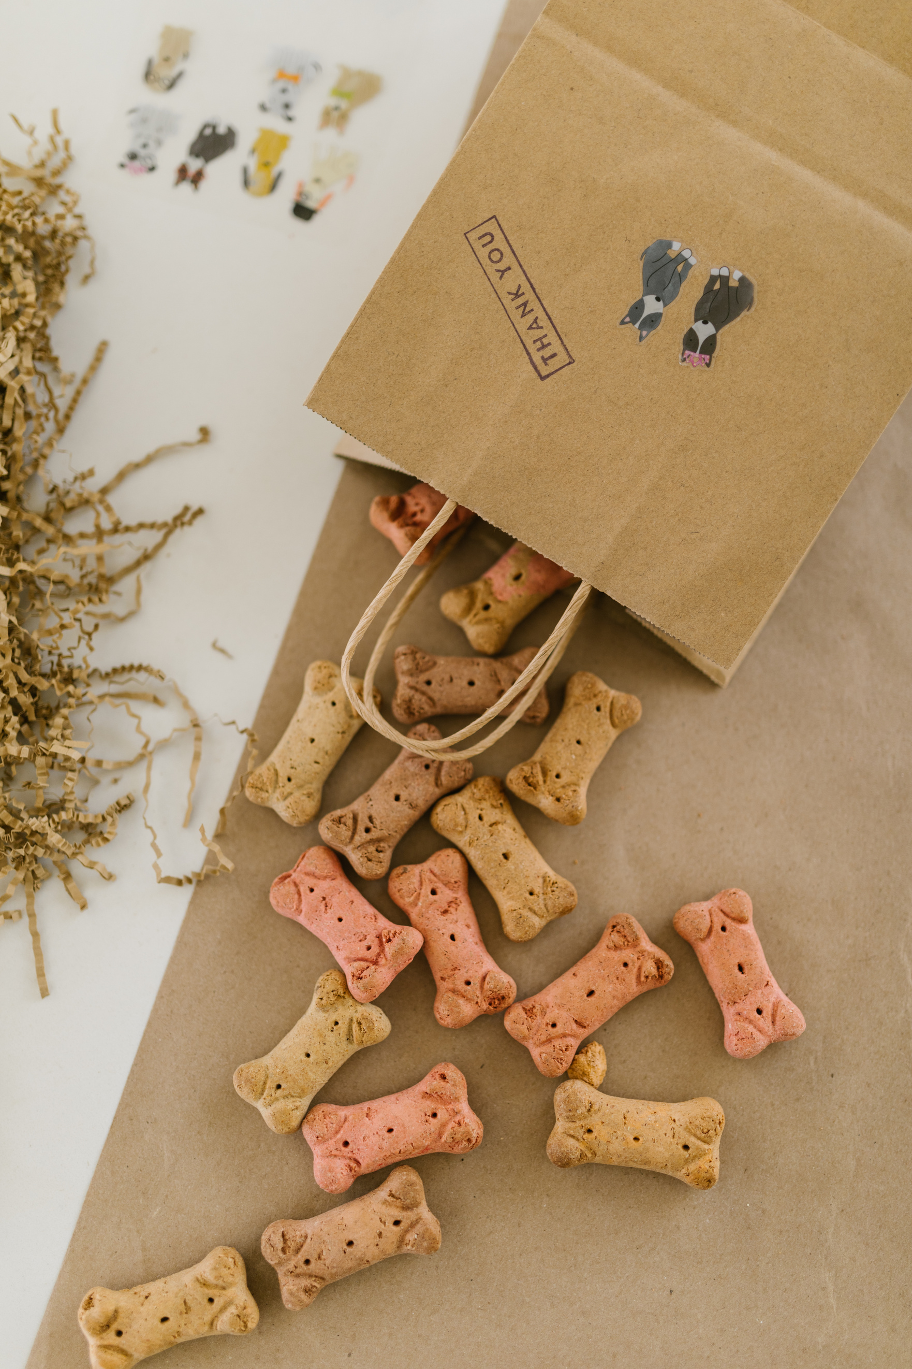
YOU PATIENTLY TAUGHT ME A LOT OF THINGS.
5. MARKET PLACE FOR PETS
  Animal Food
  Animal Accessories
  Toys, Belts
  Cages, Aquarium

Slide 16
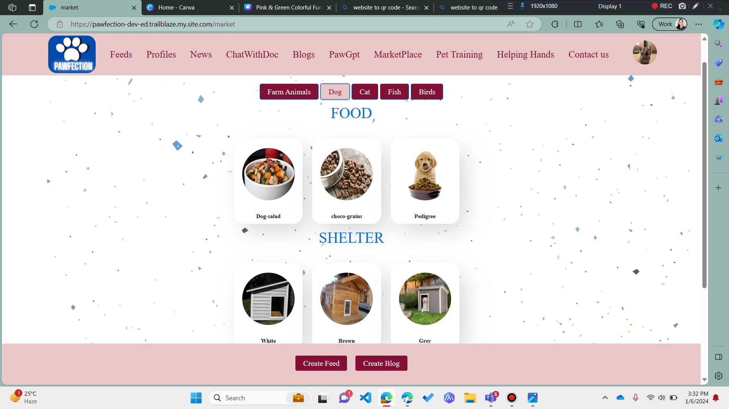
Market Place

Slide 17

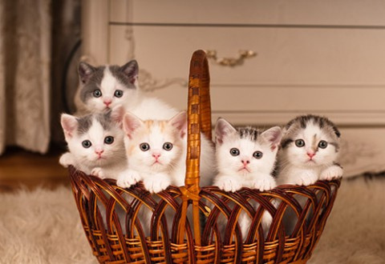








Valentine's Day or not, I'll never get tired
of saying I love you to you.
6. TRAIN PETS BY LOOKING AT FAMOUS VIDEOS
EMBEDED FROM YOUTUBE

Slide 18
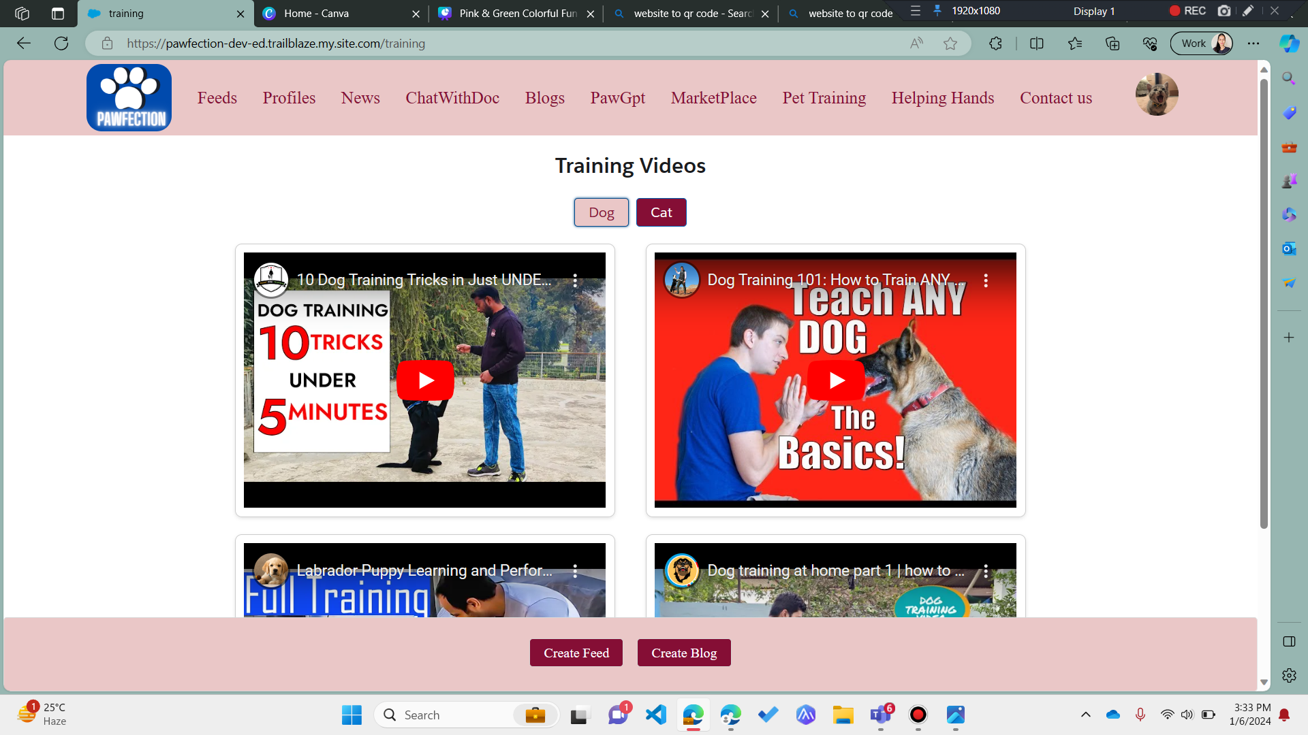
Training

Slide 19
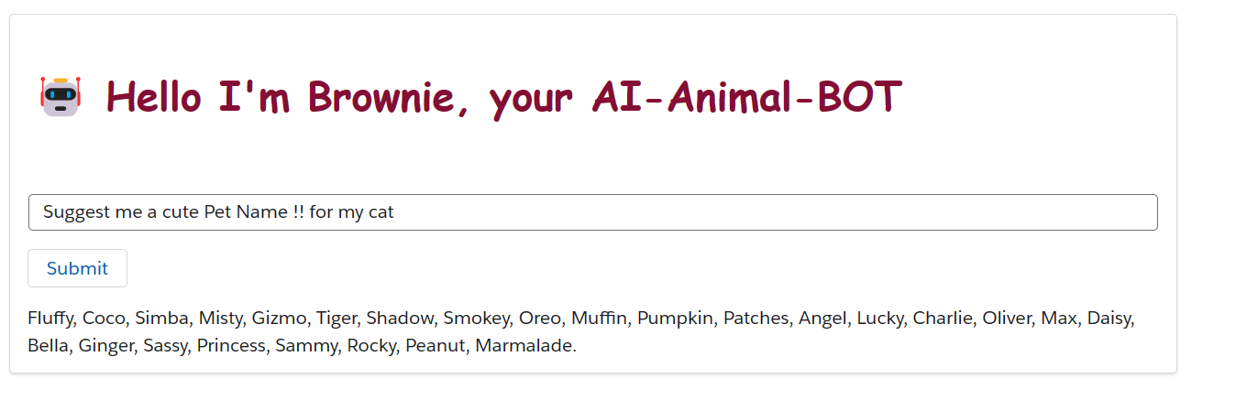
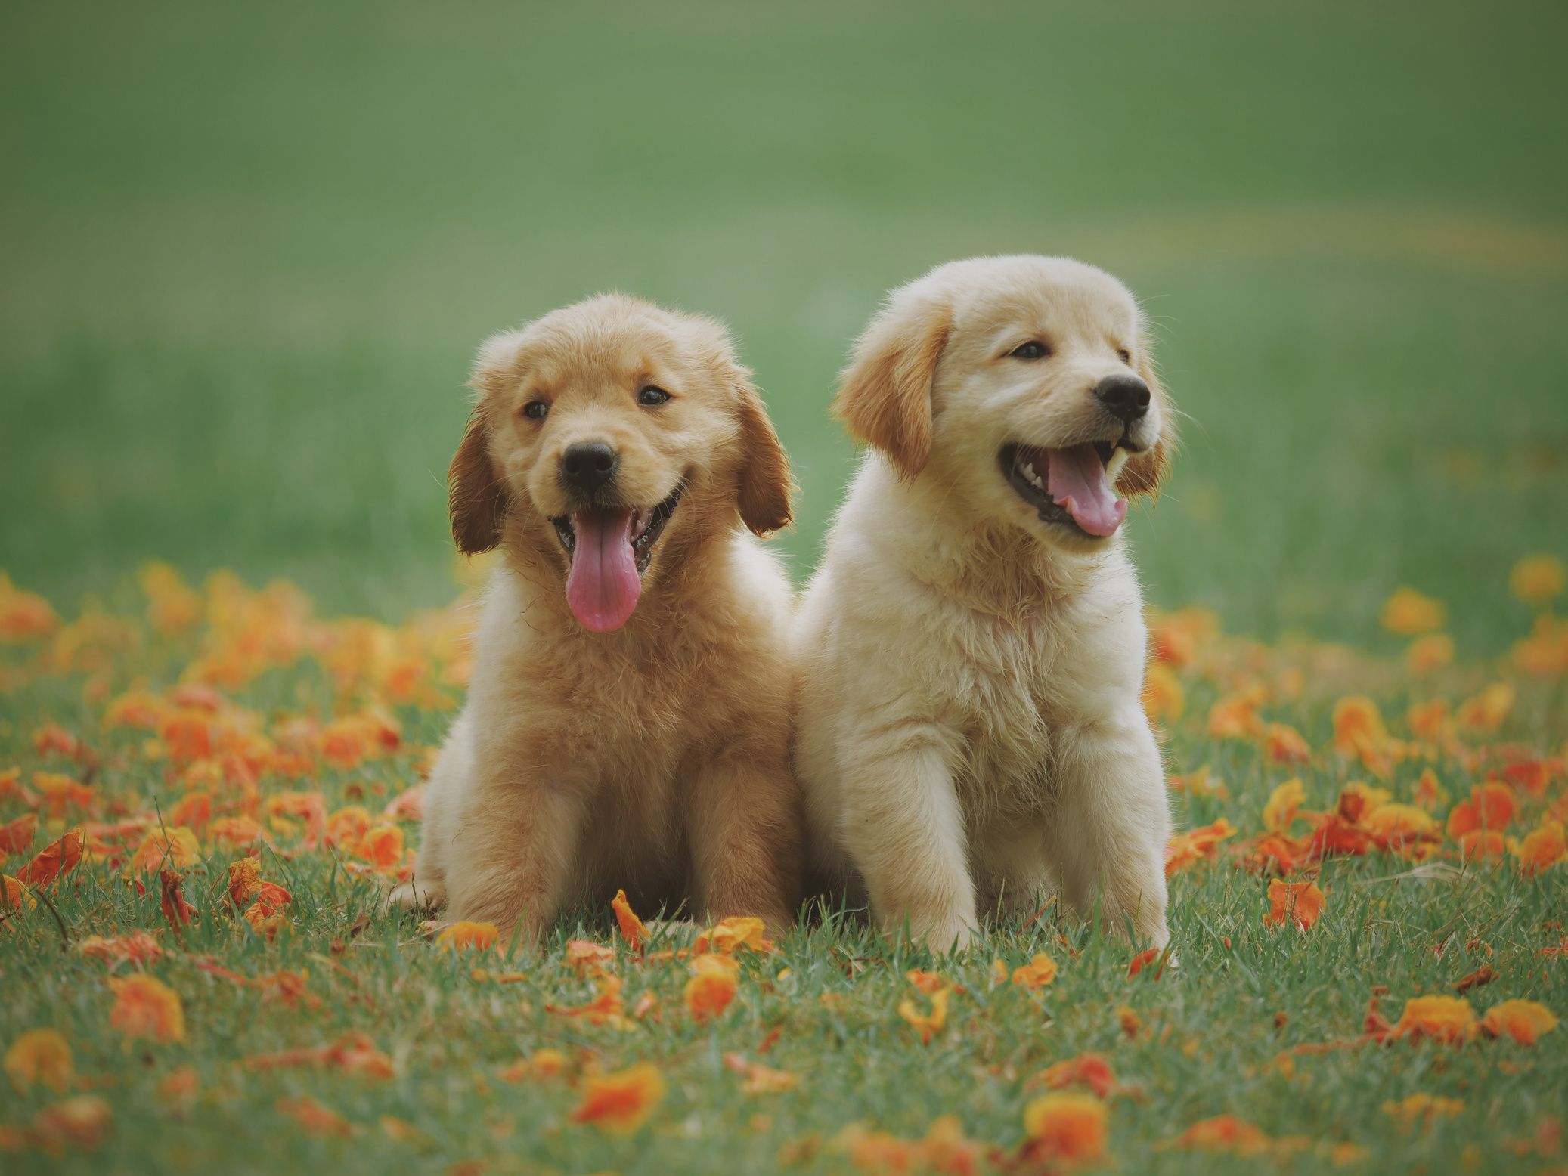
7. Paw-GPT to ask questions for your Pets

Slide 20

SCAN THIS QR CODE TO CHECK GIT-HUB CODE & TECH-STACK USED
Scan this to see what
I'm talking about!

Slide 21

DID YOU KNOW YOU HAVE THE MOST BEAUTIFUL AURA IN THE WORLD?
Scan this to see what
I'm talking about!

Slide 22
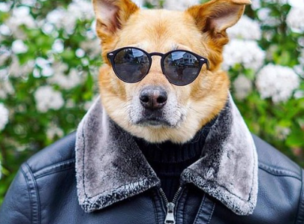
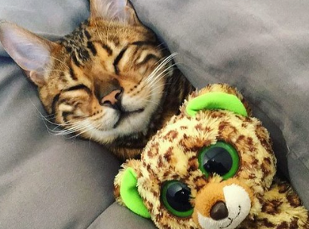
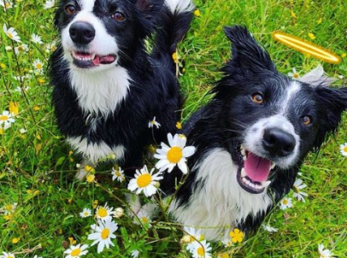
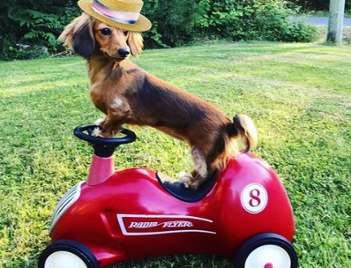
Join us on this extraordinary journey at Pawfection – where every pet, every owner, and every moment is celebrated in the name of love and companionship.
Together, let's create a world where every paw finds its perfect place.

Slide 23

Presented By
Team Coderangers
Hrishikesh, Mousin, Nayan

Slide 24
