Slide 1







Lost and Found
SALESFORCE IMPACT HACKATHON 2023
By Mayank and Prajwal

Slide 2



Mayank khadotkar
Lead Software Engineer
@Persistent System Ltd
Exp : 3.1 years
Prajwal Khajure
Software Developer
@Scideas Solutions Pvt. Ltd
Exp : 1.5 years
Our Team
Lost and Found
Salesforce Impact Hackathon 2023

Slide 3



Agenda
What is Lost and found ?
Motivation Behind this Topic
Design Architecture & Search Logic
Demo of Application and document and video link
More Impovement planned in project
How it is impacted to Society

Slide 4


What is Lost and found ?
The "Lost and Found" project is a comprehensive system designed to streamline the process of reporting lost items, facilitating their recovery, and reuniting them with their rightful owners.

Slide 5
Motivation Behind this Topic
Personal Experience
Observation of Common Issues
Community Well-Being
Empathy and Connection
Passion for Technology and Social Impact
Inspiration from Social Impact Themes

Slide 6
Design Architecture
Lost
Display all the list of matching records
Present on database ?
Yes
Enter Details
select your item
Found
No
Enter the Authentication question
Answer the Authentication question set while storing the record
correct
we will send email to both user with contact details
Start of flow
Record saved into database
End of Flow
Incorrect
item is not yours

Slide 7
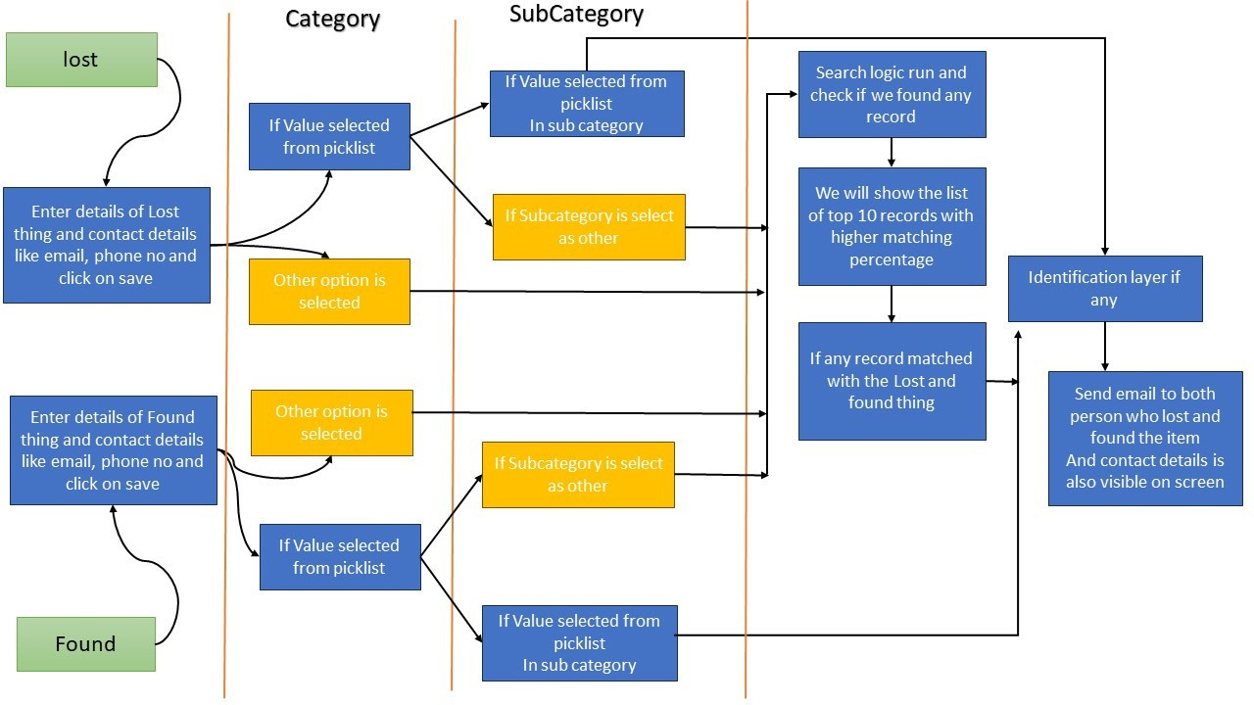
Search Logic

Slide 8

Demo Of application
Technical Document

Slide 9
More Impovement planned in project
  Batch class to delete data after specific time period.
  Upload image at the time of authenciation screen.
  Status of record Active or inactive.
  Enhasment on search based on the Image processing.
  And many more...

Slide 10


How it is impacted to Society
Community Collaboration
Reduced Stress and Anxiety
Time Efficiency
The application fosters a sense of community collaboration by enabling individuals to help each other in locating lost items.
project aims to reduce the stress and anxiety associated with losing valuable items. The quick and organized retrieval process contributes to the emotional well-being of individuals.
the efficient handling of lost and found items saves valuable time for both those who lost something and those who found it. This can have a direct positive impact on people's daily lives.
Resource Optimization
Positive Environment
Long-Term Impact
The automation of the lost and found process contributes to resource optimization, This can include saving manpower, reducing physical paperwork, and making the process more environmentally friendly.
project is targeted at educational institutions, public spaces, events and any large organization, A more efficient lost and found system can create a positive and organized environment.
"Lost and Found" project has the potential to make a positive social impact by improving efficiency, reducing stress, fostering community collaboration, and contributing to a more organized and connected society.

Slide 11

Thank you!

