Slide 1
DualHorizon Solutions
Where We Thrive to provide the Best Salesforce Service!
Consulting Team:
Yogesh Kanaki, Sasmita Biswal, ShawnSmothers

Slide 2
Problems Facing U.S and other Food pantries
their information securer. Inflation on the rise and massive lay off have led to an increase in individuals using govt assistance.
According U.S Today news food pantries/banks are experiencing a higher demand of hungry individuals but low supply of food. Not enough food is being donated to meet the higher demand.
Feeding America stated “April 17 and May 1, around 95% of responding food banks reported seeing demand for food assistance”
According to Axios study “44 million people were living in food insecure households in 2022, according to the USDA, a 31% increase since 2022 and the largest one-year increase since 2008”.
Axios also notes ‘13 million children were food insecure in 2022, a 44% increase since the prior year.
Another key problem seems to be tracking donations and keeping

Slide 3
Global Food Pantry Systems off a solution
When food is below 10 qtl we wend an alert to contact donors for more supply.
Volunteer Sign to be a volunteer and volunteer sing up for a shift
Food Pantries/Banks are scored by health food items on shelve and social events hosted such as food awareness.
Donor information is tracked.
Reports on who donated the most.

Slide 4
The Application focuses on 2 main parts:
Tracking donors securely and donated items:
Allows Food Pantries to call donors in their data based when food or supply is needed.
Alerts coordinator when food items are below 10 QTL to collaborate with donors for more product.
2) Promote wellness throughout the community with events:
Food Pantries using the system can go beyond donating and host events.
i) neighborhood cleanups
ii) Health awareness meetings
iii) Social events
3) Increase Volunteer access to be a volunteer and track volunteers:
Volunteers can be utilized to work shifts and assist with the shortage of paid staff. Due to the understaffing, volunteers can be employed to complement the workforce.

Slide 5
Coordinator tracking donors user story
User Story
As a food pantry coordinator, I want a donor tracking system to efficiently monitor and record the items donated by each donor to our specific food pantry.
Acceptance Criteria
When using the system, I should be able to easily input and retrieve donor information, view a history of their donations, and identify items they prefer not to donate. The system should provide a user-friendly interface for quick data entry and retrieval.

Slide 6
Current Donor and Item process
Donor and Item Paper form
Enter In Excel

Slide 7
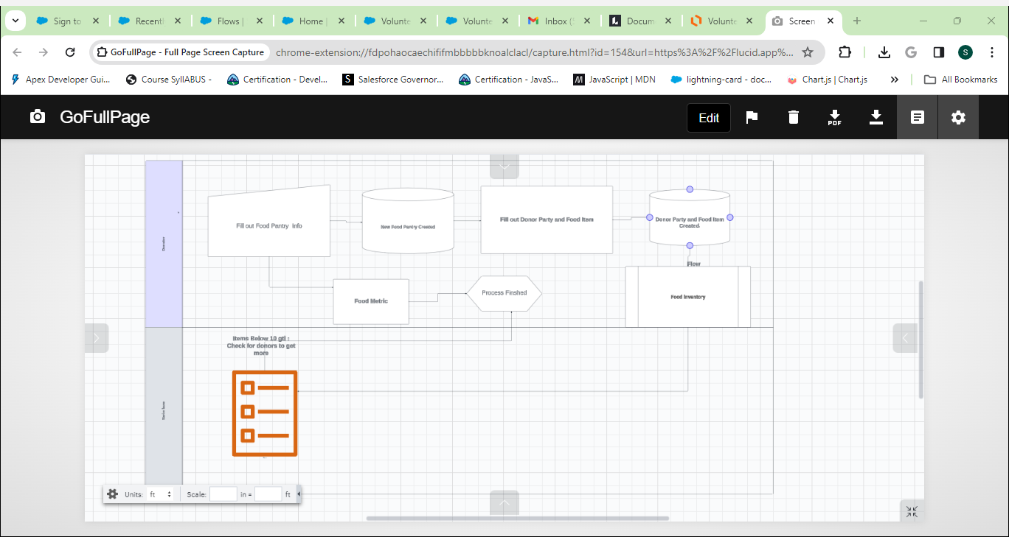
Future Food Panty Donor and Items Process

Slide 8
Volunteer Form User Story/Acceptance Criteria:
User Story
As a prospective volunteer, I want to easily fill out a form on the website to express my interest in volunteering.
Acceptance Criteria
The website should have a visible "Volunteer" link on the homepage leading to a form with fields for basic information. Submitting the form should trigger a confirmation message, with clear error messages for any issues. A confirmation email should be sent, outlining the next steps.

Slide 9
Food Pantry Coordinator Task User Story Acceptance Criteria
User Story:
As a coordinator, I want a task to be automatically created when a volunteer record is generated, allowing efficient coordination with the volunteer.
Acceptance Criteria:
Upon the creation of a volunteer record, an associated task should be automatically generated so I can gather more details about the new volunteer.

Slide 10
Volunteer Sign Up To Work Form
User Story:
As a volunteer, I want the ability to sign up for either a food pantry event or food pantry shift after completing the volunteer registration process.
Acceptance Criteria:
Upon registration, I should be able to choose food pantry and pantry event to volunteer at. Also should receive a email conformation.

Slide 11
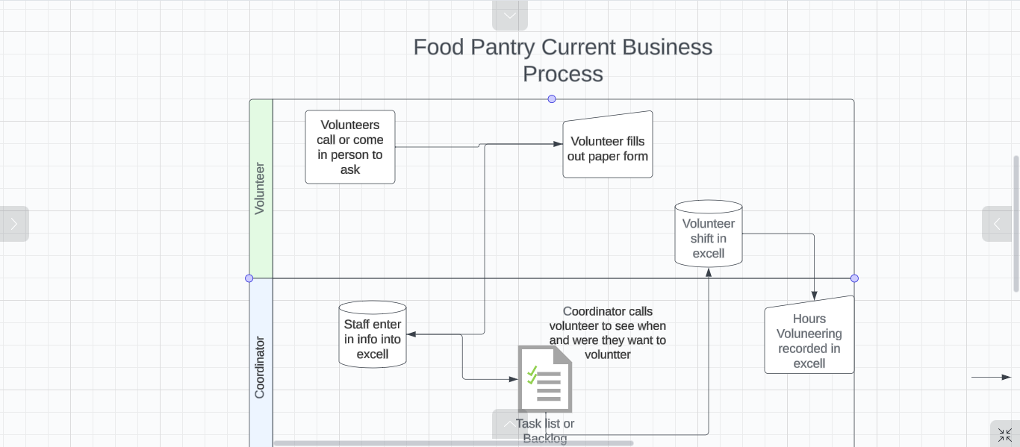
Current Food Pantry: Volunteer Process

Slide 12
Future Process to Become a Volunteer process

Slide 13
Future Shift Sign up Form Process

Slide 14
The whole Volunteer Future Process
1) Volunteer Registration:
Guest accesses the organization's website.
Guest navigates to the "Be a Volunteer" section.
Guest fills out the volunteer registration form.
Upon submission, a record is created in Salesforce.
2) Approval Process:
A flow is triggered in Salesforce upon the creation of a volunteer record.
The flow initiates an approval process.
A task is created to notify the coordinator about the new volunteer record and the need for approval.

Slide 15
The whole Volunteer Future Process
3) Coordinator Approval Task:
Coordinator receives a task notification to review the volunteer record.
The task prompts the coordinator to decide whether to approve or reject the volunteer.
If approved, the volunteer status is updated to "Active Volunteer."
4) Sign Shift Form:
Approved volunteers can access the "Sign Shift Form" on the website.
5) Volunteer Event/Shift Selection:
Volunteers can choose to participate in events or shifts at a food pantry through the form.

Slide 16
The whole Volunteer Future Process
7) Record is saved
Sign up form record for either food pantry or event is created in the system
8) Communication:
Email is sent out the to those that fill out the form letting the volunteer know what they signed up is automatically sent out.
9) Hours Tracking:
Once a volunteer completes a shift, the system tracks their hours.

Slide 17
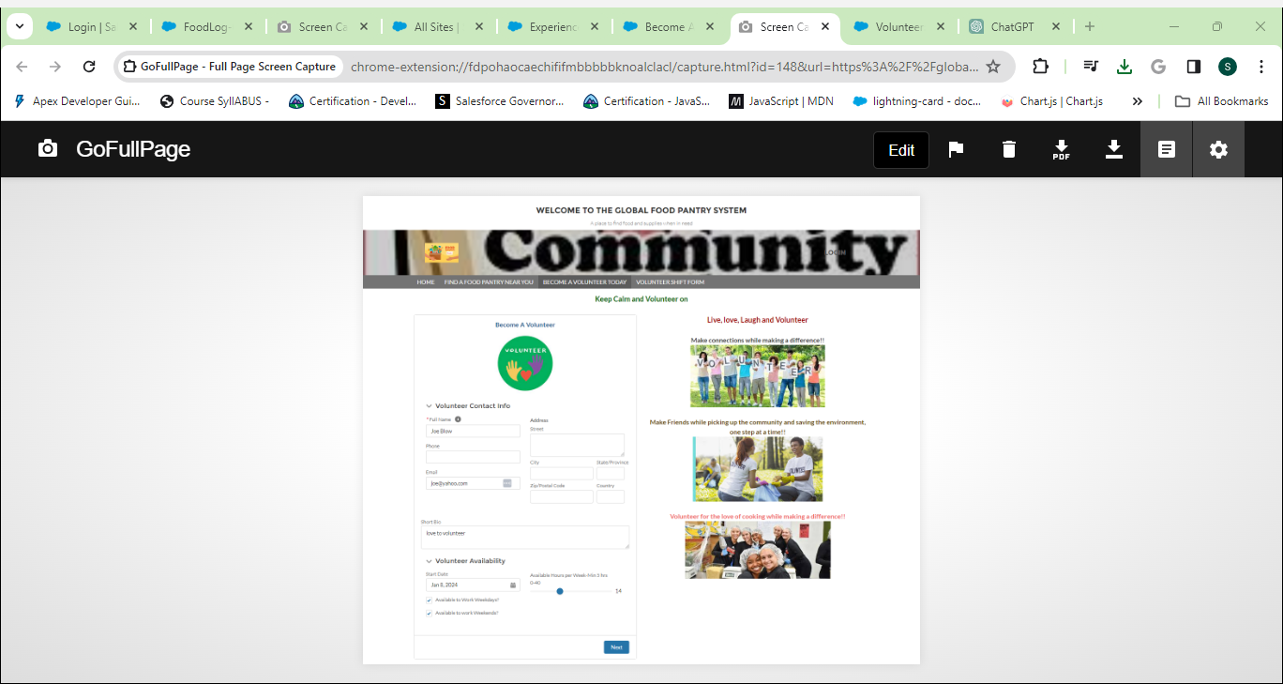
Become a Volunteer Form

Slide 18
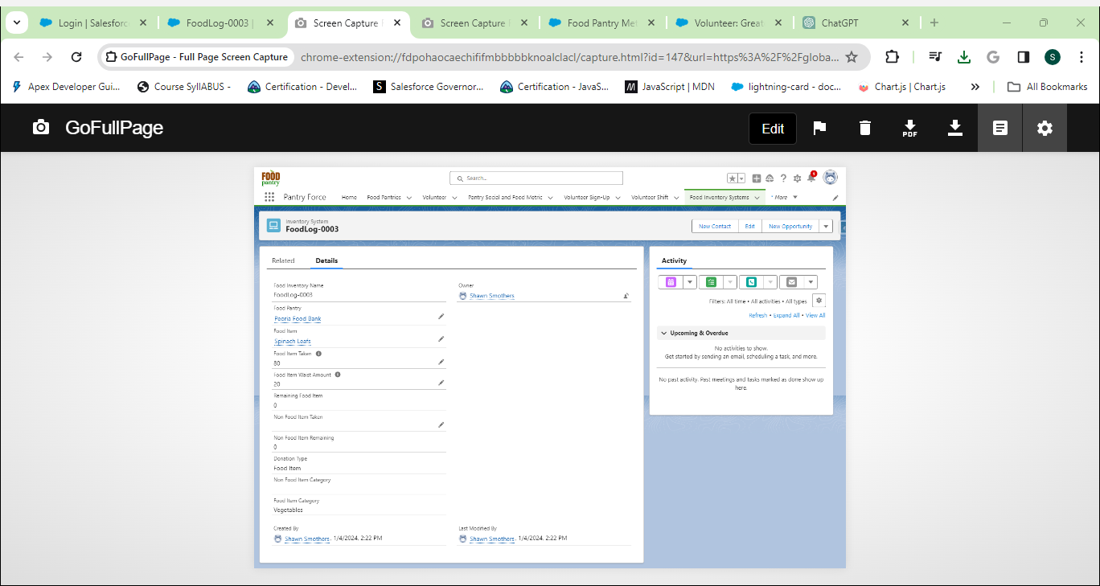
Inventory

Slide 19
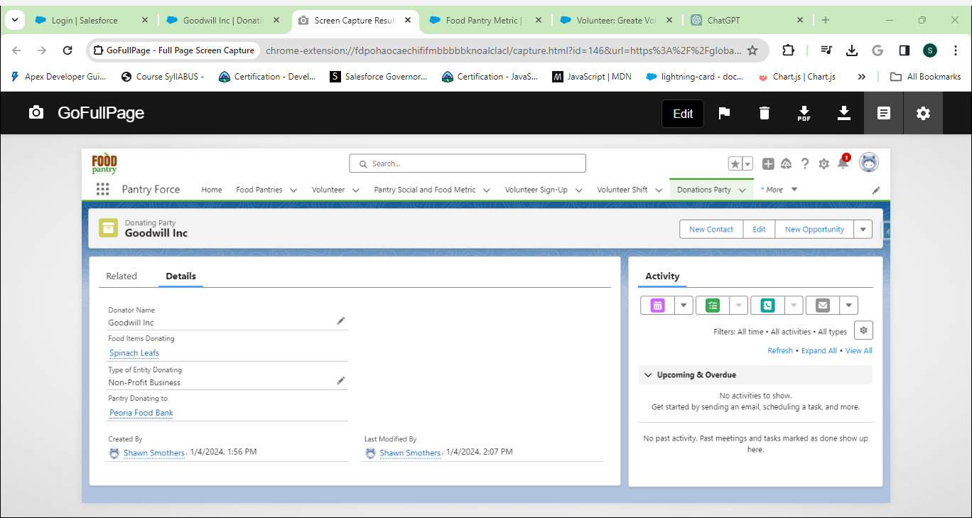
Donation Junction Obj

Slide 20
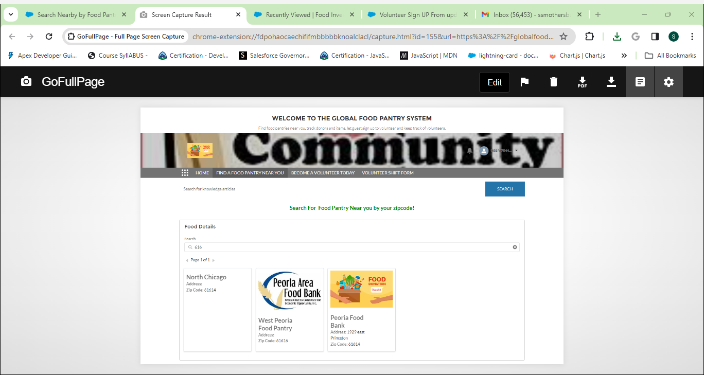
Food Pantry Search LWC

Slide 21
Thank You

