Slide 1


CRIME FREE INDIA
By Nilkanth Patel

Slide 2



PROBLEM STATEMENT
  The problem at hand is lack of places information and comprehensive safety measures to ensure the well-being of tourists in various regions across India.
  Due to lack of information what happening is Citizens are not feeling Safe while going to unknown places and remains silent while being victim of crimes done by thieves/criminals.
  This problem statement aims to explore the following key areas:
Safety Infrastructure
Awareness and Information

Slide 3




KEY AREAS IN PROBLEM
1. Safety Infrastructure:
2. Awareness and Information:
  There is a need to assess and improve the safety infrastructure across popular tourist destinations in India.
  This includes enhancing lighting, installing CCTV cameras, and improving police presence to deter criminal activities and provide immediate assistance in case of emergencies.
  Many tourists lack essential information regarding safe travel practices, local laws, and emergency contact numbers.
  There is a need to develop comprehensive safety guides and ensure that tourists have access to accurate and up-to-date information.

Slide 4

HOW THIS CAN BE SOLVED?
  All Places should be having good Safety Infrastructure like CCTVs, Lighting, etc.
  Business/Government should record all information as Security Records in System.
  All Information about places like Police & Police Station Information, Area Score, Safe Places, Local Guidance Tips, etc. should be available to All Citizen at his Fingertip (By Mobile App/Web App).
  Business should implement Crime Reporting tool for Citizens.

Slide 5
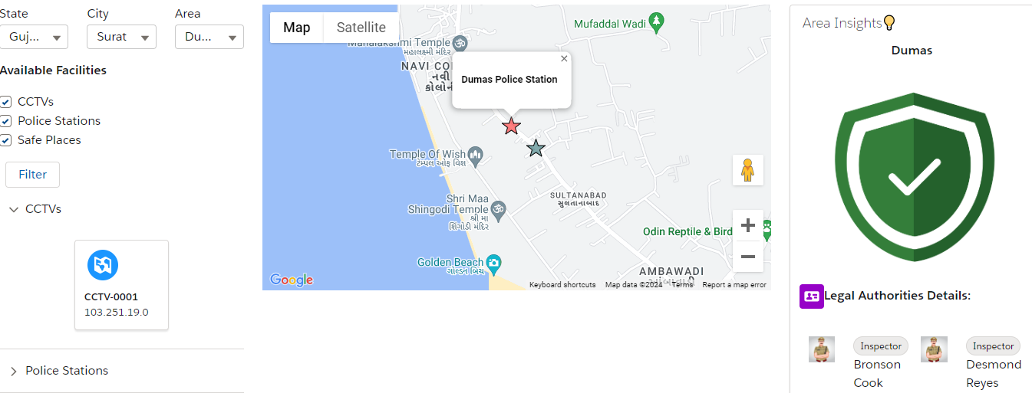
MY IDEA💡
  Crime free india is web app for indian citizens to get places details like cctvs, police stations, safe places. They can also report crime by just visiting same portal.

Slide 6
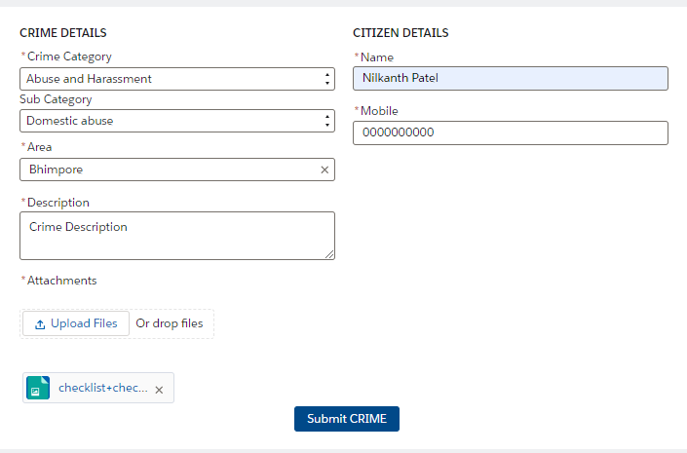

REPORT CRIME AT FINGERTIP
  Reporting crime is now easy with CRIME FREE INDIA Web App. Citizens can easily report crime around his places and get resolution faster.
SUBMIT CRIME
CREATES CASE
RESOLUTION
HAPPY CITIZEN

Slide 7

IMPACT ON SOCIETY
  Travel Safely with Family at Unknown Places
  Precautions Steps will be taken with available Information
  Report Crime & Resolve Faster with Technology
  Trust from Citizen to Government will increase
  Overall Country Infrastructure will be more developed
  Safety will increase and as a result crime rates will decrease

Slide 8
REFERENCE
CRIME FREE INDIA PORTAL
https://crimefreeindia2-dev-ed.develop.my.site.com/homepage/
1. DEMO:
Link -> https://drive.google.com/file/d/1eFuEqorZ6ZkAM81h4XYgU4tOauQdW5V0/view?usp=sharing
2. DEVELOPER GUIDE:
Link -> https://drive.google.com/file/d/1yPA832dK1v0bahSN1fgcP3fkG8AMn4_5/view?usp=sharing

Slide 9
THANK YOU

