Slide 1
Cause Connect
NGO Volunteer Connect

Slide 2
MOTIVATION
The idea originated from the realization that while countless individuals yearn to volunteer their time and skills, the process of connecting with suitable NGOs often posed challenges.
Leveraging the power of Salesforce, I designed a user-friendly platform that not only allows volunteers to seamlessly find and apply to NGOs but also empowers non-profits to efficiently manage and engage with their volunteer base.

Slide 3
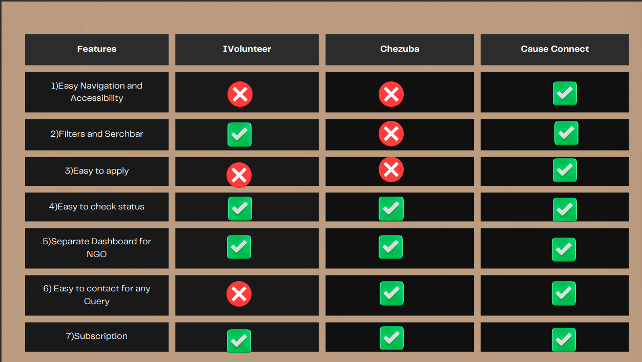
Comparison with other Platforms

Slide 4
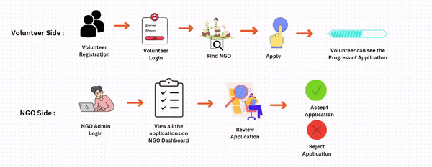
Workflow For Cause Connect

Slide 6
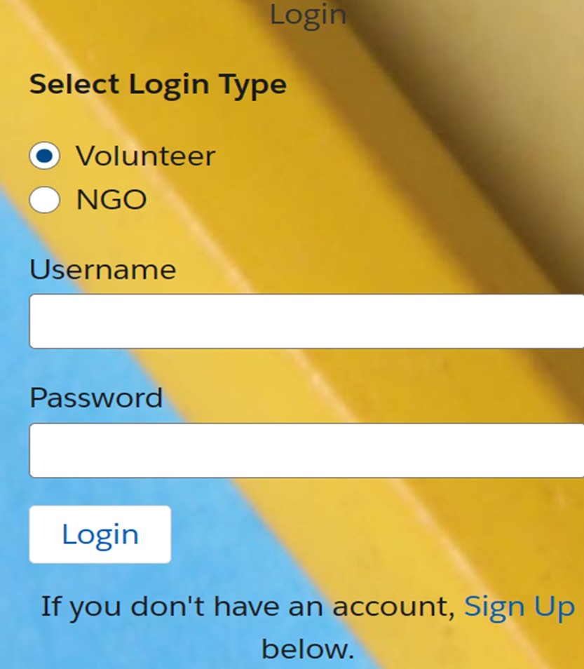
USER LOGIN
THE LOGIN PAGE ALLOWS USERS TO ACCESS THEIR ACCOUNTS BY ENTERING THEIR CREDENTIALS.

Slide 7
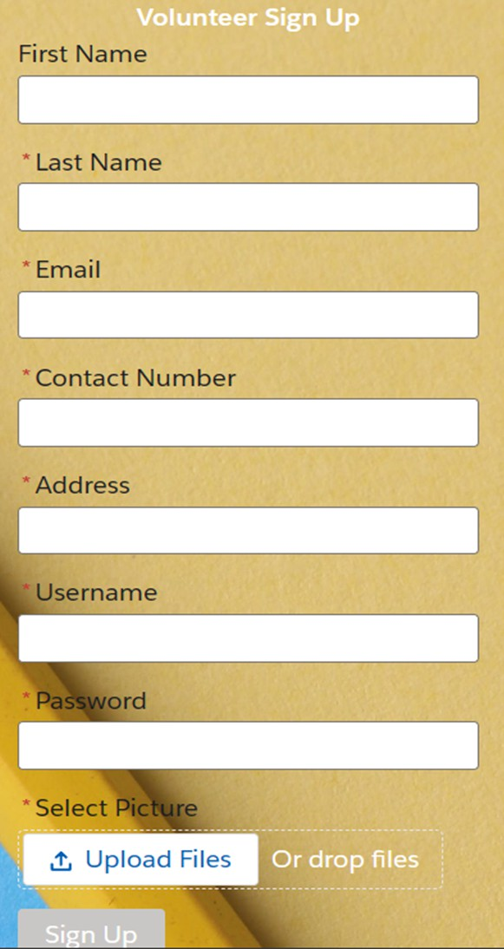
SIGN UP PAGE
THE SIGN-UP PAGE OF THE NGO- VOLUNTEER CONNECT WEBSITE ALLOWS USERS TO CREATE AN ACCOUNT AND ACCESS VARIOUS FEATURES.

Slide 8
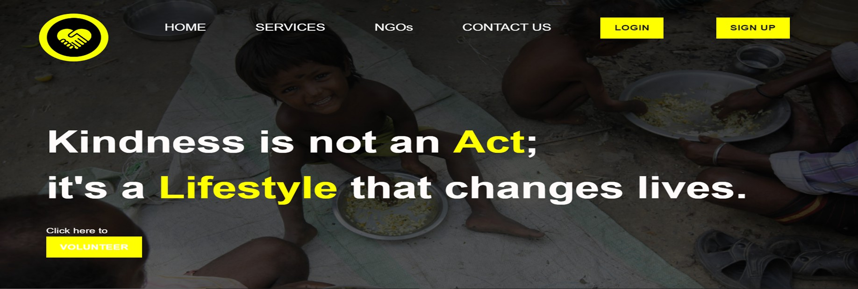
HOME PAGE
WELCOME TO THE CAUSE CONNECT WEBSITE! WE ARE DEDICATED TO CONNECTING NGOS WITH PASSIONATE VOLUNTEERS TO MAKE A POSITIVE IMPACT IN THE COMMUNITY.
OUR PLATFORM OFFERS A RANGE OF FEATURES TO STREAMLINE THE VOLUNTEERING PROCESS AND ENSURE A SEAMLESS EXPERIENCE FOR BOTH NGOS AND VOLUNTEERS.

Slide 9
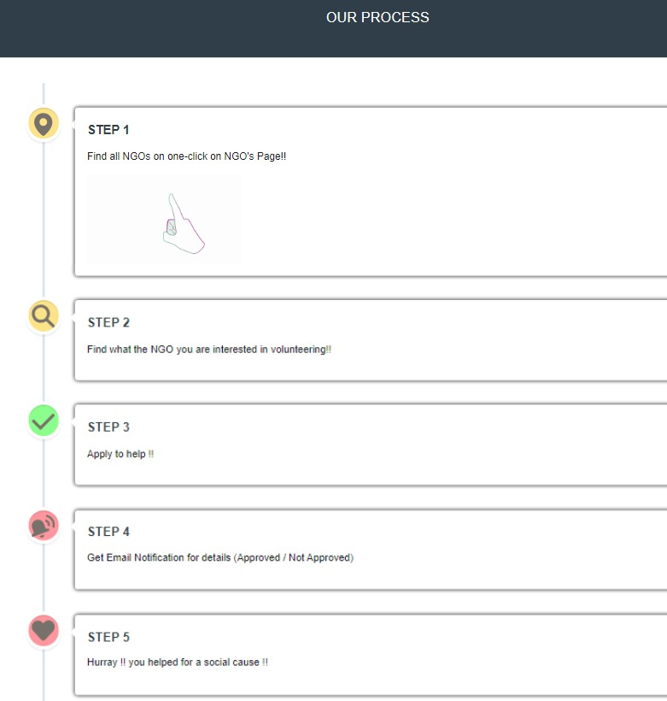
HomePage
On the home page, you will find information about our mission, vision, and the services we offer.
Additionally, you can easily navigate to other sections of the website using the menu bar at the top.
Whether you are an NGO looking for dedicated volunteers or an individual wanting to make a difference, we are here to help. Join our community today and be a part of the change!

Slide 10
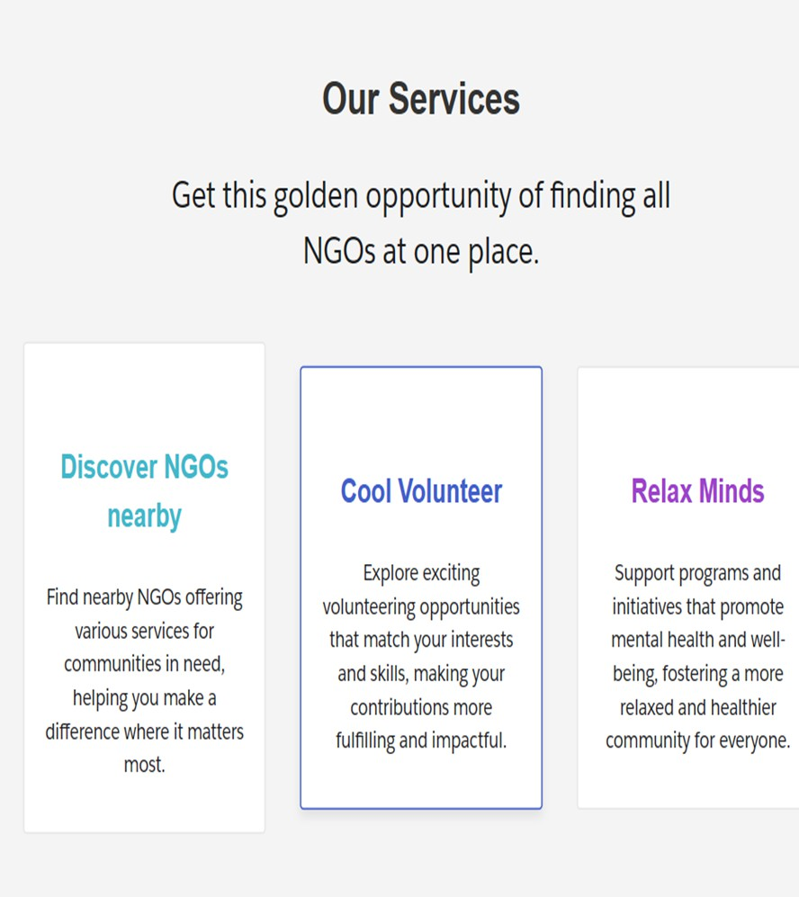
Service Page
Welcome to the Service page of the Cause Connect website.
Here, you can find information about the services offered by our NGO and how you can get involved.
Our NGO provides a wide range of services to the community, including:
Education and literacy programs Healthcare and medical assistance Environmental conservation initiatives Community development projects
We believe that by providing these services, we can make a positive impact and create a better future for all.

Slide 11
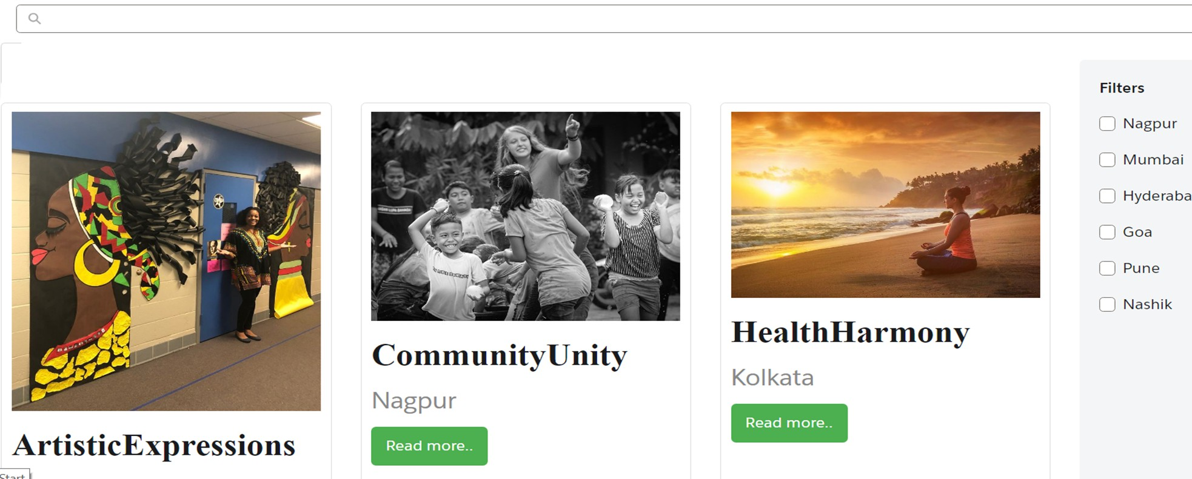
NGO Page
In this Page you can Discover various NGOs for Volunteering Here we have also Added Search bar and Filters

Slide 12
NGO Apply Page
Here you can Read about NGO’s in Details ,their location
apply for the Volunteering
on Map and also can

Slide 13
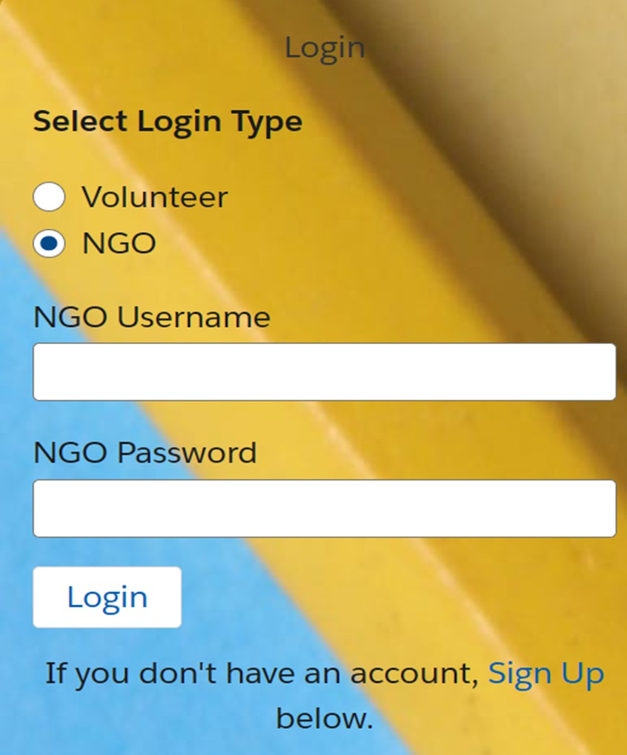
NGO Login
The NGO login page is specifically designed for NGOs to access their accounts and manage their information.

Slide 14
Volunteer Applications Page
Review and Accept/Reject Applications
On the Volunteer Applications page, NGOs can review the applications submitted by volunteers and choose to accept or reject them.

Slide 15
Applicant Information Page
Review and Accept/Reject Applications

Slide 16
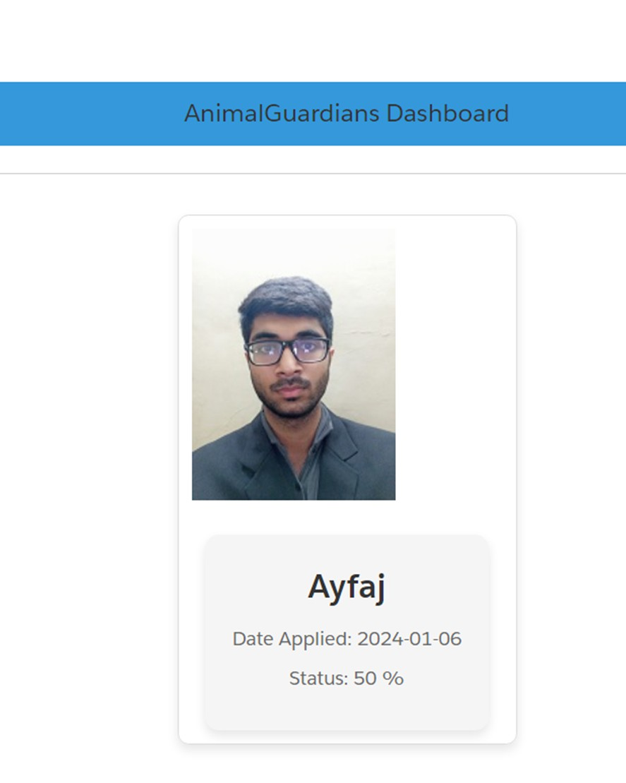
After Accepting/Rejecting Volunteer by NGO that volunteer will disappear from NGO dashboard

Slide 17
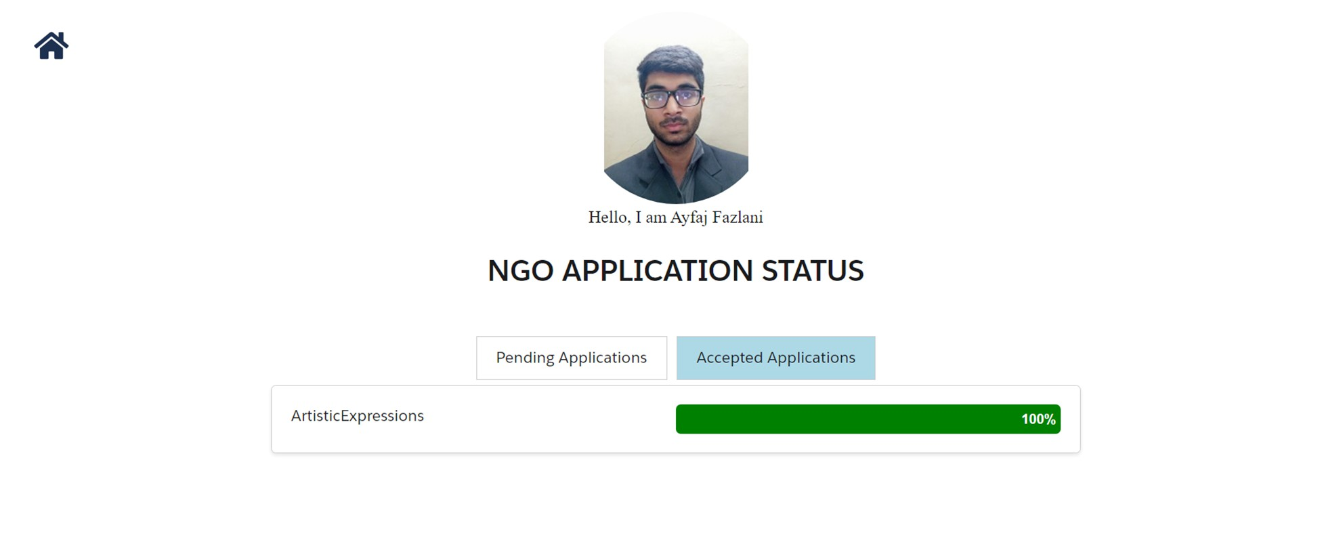
My profile Page
Here volunteer can see Pending/Accepted Applications

Slide 18
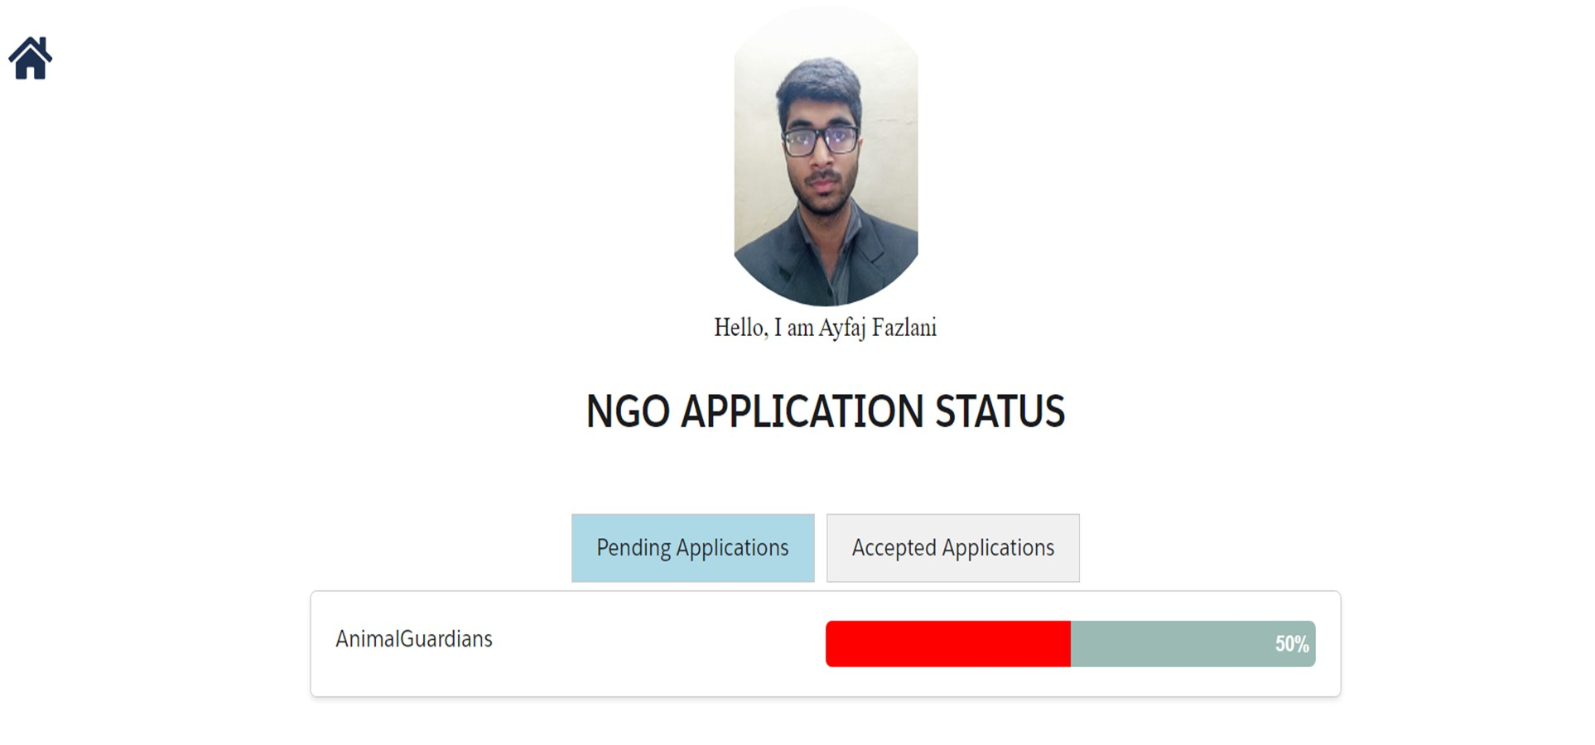
Pending Applications in my Profile

